Slide 1
AP Calculus AB/BC

Slide 2
Courses Offered
AP Calculus AB (11th – 12th grade)
First year calculus course
Course covers limits, derivatives and integrals
Pre-Requisite Courses: Precalculus or Accelerated Algebra 2
AP Calculus BC (12th grade)
Second year calculus course (Calculus 1 and 2)
Covers limits, derivatives, integrals, series convergence, power series, polar and parametric curves
Pre-Req: AP Calculus AB

Slide 3
Benefits of AP Calculus
Explore topics through rich, contextual, real-world based problems
Passing AP Exam with a score of 3 or higher could earn you college credit for Calculus 1 and/or 2
Gain valuable critical thinking skills
Work collaboratively with classmates on a daily basis
Have FUN doing math!

Slide 4
AP Exam Success
We have over 120 students enrolled in AP Calculus AB
We have over 45 students enrolled in AP Calculus BC
80%-90% of students have earned a 3 or higher the last 3 years in AP Calculus AB
Over 95% of students have earned a 3 or higher the last 3 years in AP Calculus BC

Slide 5
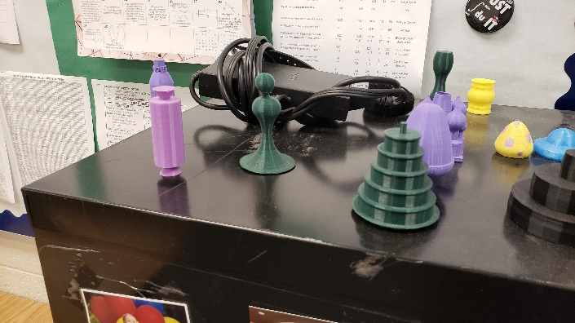
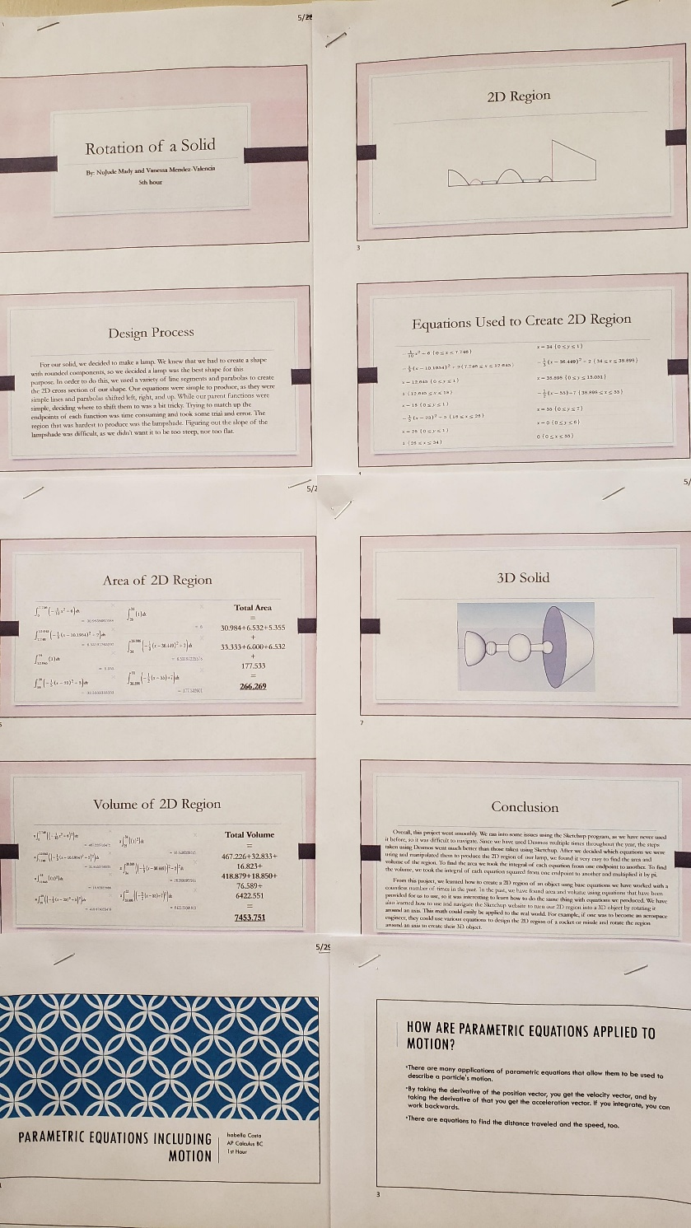
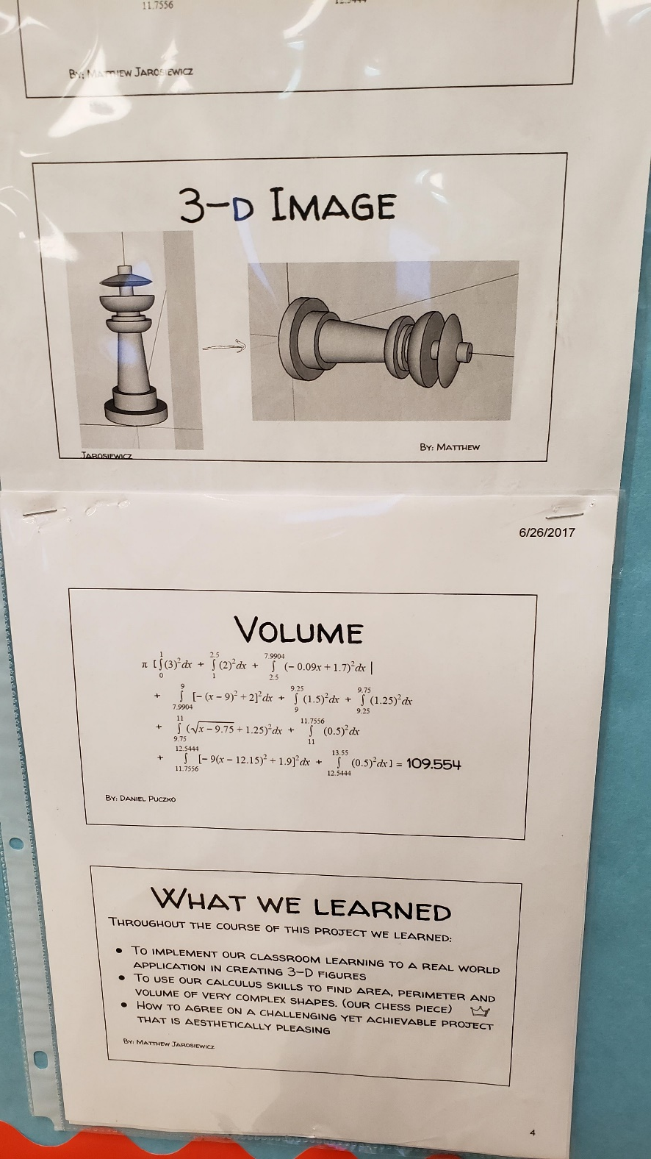
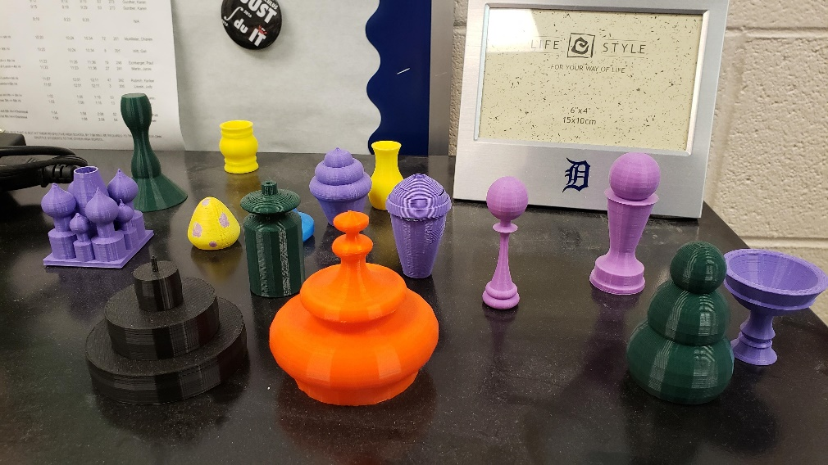
Fun Projects
In the past we have done cool projects that include
Doing the Dishes (Investigation of incoming and outgoing rates)
Integration Bee
3D Solids of Rotation Project using 3D software and a 3D printer

