Slide 1
Dakota’s Key Club
“Caring- Our Way of Life”
Dakota’s Key Club is all about giving back to our community. It gives our members an opportunity to provide service, volunteer for a variety of events, and develop leadership skills. It is not just about the hours, it’s about having fun and helping others.

Slide 2
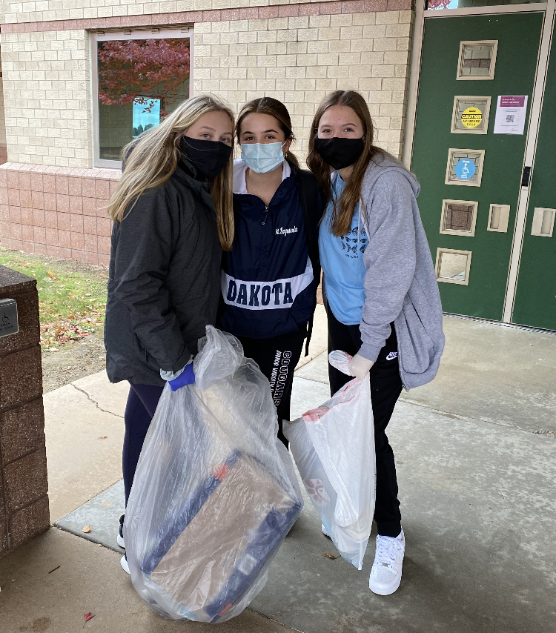
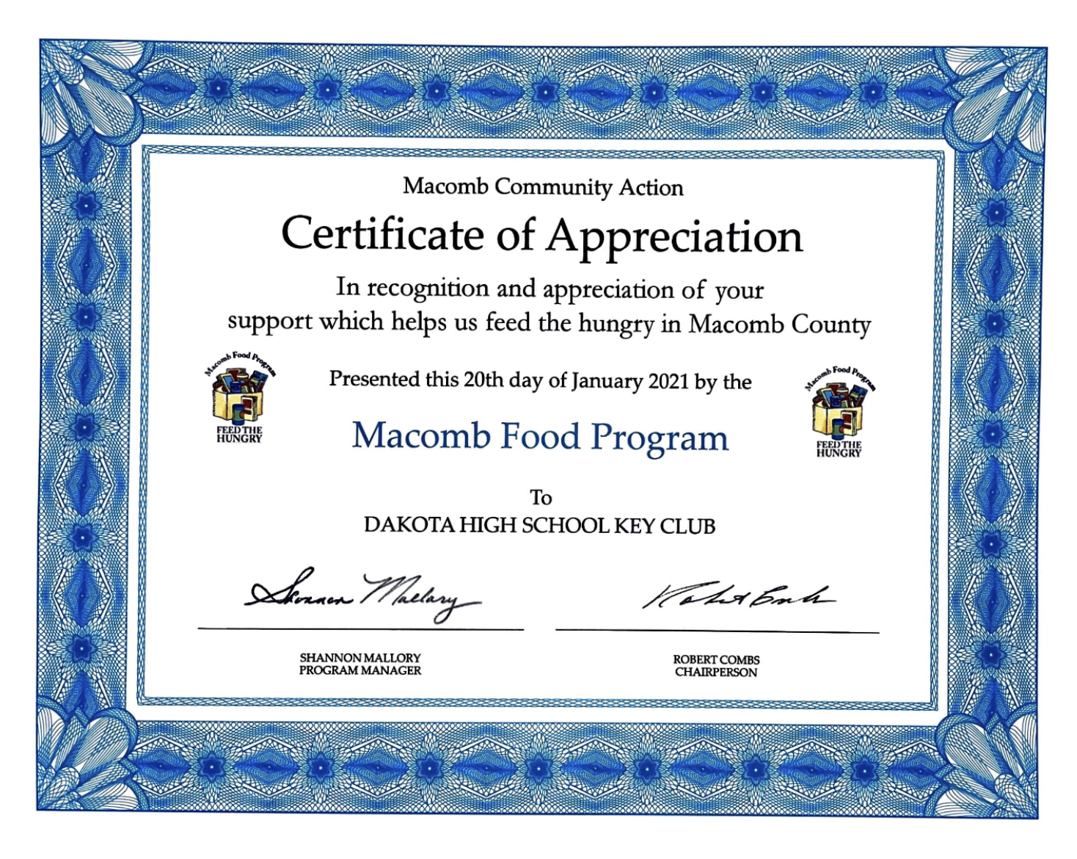
For more information visit about Key Club visit dakotakeyclub.weebly.com or scan the QR code
Places we have helped in the past…
-Humane Society
-Kiwanis
-Hospice Care
-Vietnam Veterans of America
-Macomb Recreational Center
-St. Jude Children’s Hospital
-Nursing Homes
-Friends of Foster Kids
And More!
Hope to see you next year!!

